Slide 1
COMP90007 Internet Technologies Workshop
Week 7
Ruixi
huor@student.unimelb.edu.au

Slide 2
Review
IP Address (32bits) has two components,
the network address and the host address.
Network
Host
A subnet mask separates the IP address into the network and host addresses, by setting network bits to all "1"s and setting host bits to all "0"s

Slide 3
Route aggregation
Instead of splitting an address block into subnets(Subnetting), here we combine multiple small prefixed into a single larger prefix. This process is called route aggregation.
The resulting larger prefix is sometimes called a Super net, to contrast with subnets as the division of blocks of addresses.
We can do this to reduce routing table sizes
How to do aggregation?
Longest Matching Prefix
Notes:
Each router has a routing table, for a routing table, we have several entrances. According to ur network address, the router will indicate u to go which way. By doing route aggregation, we can reduce the number of entrances, that’s how it reudce routing table sizes.

Slide 4
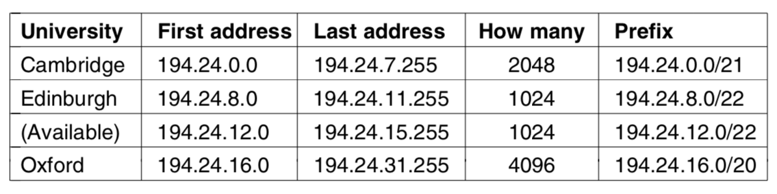
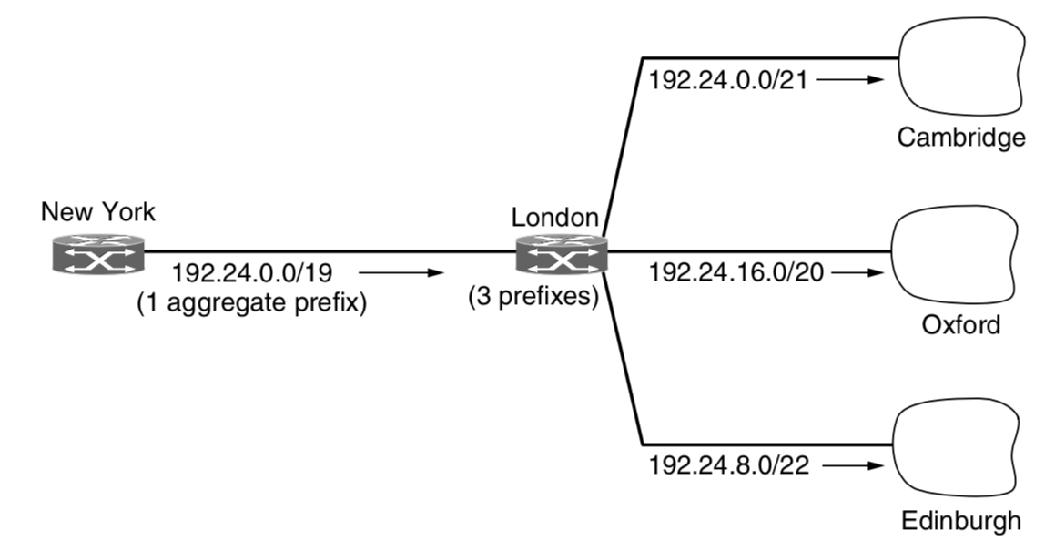
Cambridge
Starting address:
11000010.00011000.00000000.00000000
Longest Matching Prefix
.
.
.
.
.
2048 addresses in this range
Aggregate these 2048 address into 1 prefix: 194.24.0.0/21
Ending address:
11000010.00011000.00000111.11111111
Aggregation 11000010.00011000.00000000.00000000
Notes:
One very simple way would be for each router to have a table with 65,536 entries telling it which outgoing line to use for each host on campus. But the size of the routing table is huge.
There are 2048 different addresses. What do they have in common? The first 21bits are the same.

Slide 5
2048
8192
4096
1025

Slide 6
Longest Matching Prefix
192.24.0.0/21
11000010.00011000.00000000.00000000
192.24.16.0/20
11000010.00011000.00010000.00000000
192.24.8.0/22
11000010.00011000.00001000.00000000
Aggregation
11000010.00011000.00000000.00000000
Aggregate these 3 small prefix into 1 larger prefix: 194.24.0.0/19

Slide 7
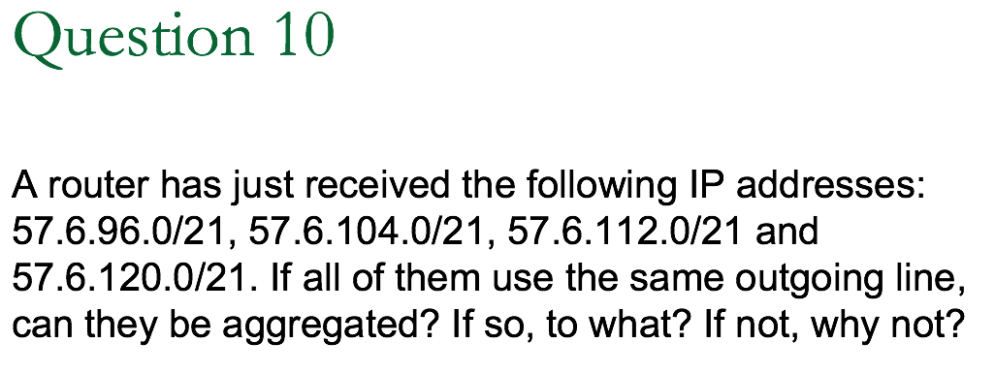




prefix
Longest Matching Prefix
00111001.00000110.01100000.00000000
00111001.00000110.01101000.00000000
00111001.00000110.01110000.00000000
00111001.00000110.01111000.00000000
Aggregation
00111001.00000110.01100000.00000000
Aggregate these 4 small prefix into 1 larger prefix: 57.6.96.0/19

Slide 8
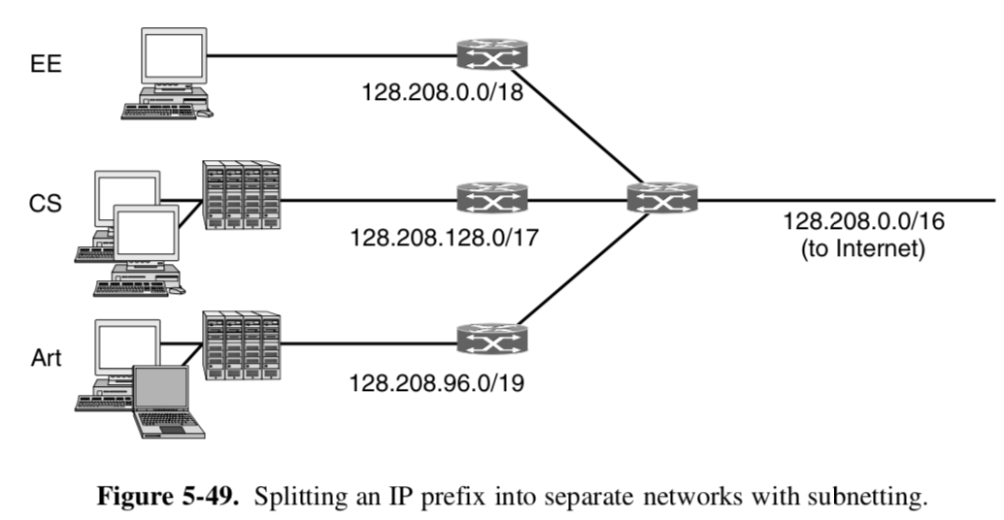
prefix/mask
2¹⁶ = 65536 hosts
Main router
Question: When a packet comes into the main router, how does the router know which subnet to give it to?
Notes:
When a packet comes into the main router, how does the router know which subnet to give it to?
One very simple way would be for each router to have a table with 65,536 entries telling it which outgoing line to use for each host on campus. But the size of the routing table is huge.

Slide 9
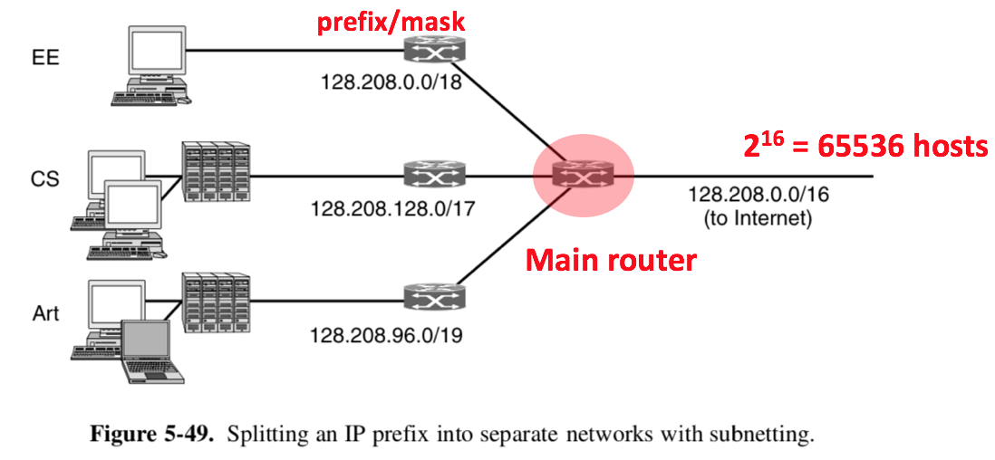
Method:
The router can do this by ANDing the destination address with the mask for each subnet and checking to see if the result is the corresponding prefix.
Destination IP Address = 128.208.2.151
10000000.11010000.00000010.10010111
To see if it is for the Computer Science Dept
Prefix/mask = 128.208.128.0/17
Subnet mask: 11111111 11111111 10000000 00000000
Result = 10000000.11010000.00000000.00000000
128.208.0.0
Doesn’t match prefix 128.208.128.0

Slide 10
Method:
The router can do this by ANDing the destination address with the mask for each subnet and checking to see if the result is the corresponding prefix.
Destination IP Address = 128.208.2.151
10000000.11010000.00000010.10010111
To see if it is for the EE Dept
Prefix/mask = 128.208.0.0/18
Subnet mask: 11111111 11111111 11000000 00000000
Result = 10000000.11010000.00000000.00000000
128.208.0.0
Match prefix 128.208.0.0

Slide 11
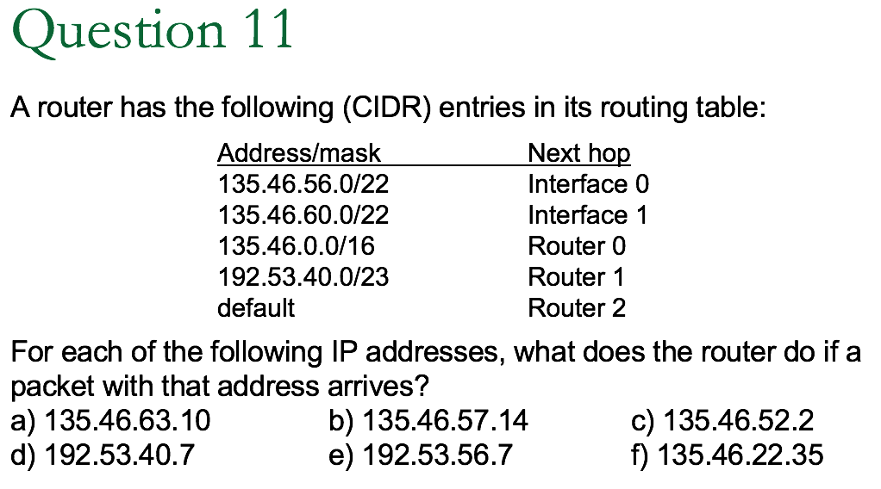
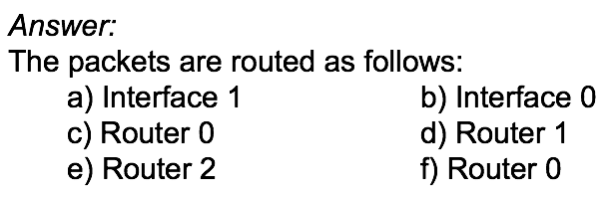

Slide 12
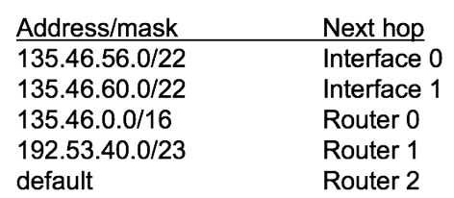

Method:
The router can do this by ANDing the destination address with the mask for each subnet and checking to see if the result is the corresponding prefix.
10000111.00101110.00111111.00001010
AND
22 bits for network addresses.
So the subnet mask is 11111111.11111111.11111100.00000000
135.46.60.0
Result=10000111.00101110.00111100.00000000
Not match prefix 135.46.56.0. So this packet is not for Interface 0

Slide 13
Method:
The router can do this by ANDing the destination address with the mask for each subnet and checking to see if the result is the corresponding prefix.
10000111.00101110.00111111.00001010
AND
16 bits for network addresses.
So the subnet mask is 11111111.11111111.00000000.00000000
135.46.0.0
Result=10000111.00101110.00000000.00000000
Match prefix 135.46.0.0.

Slide 14
Method:
The router can do this by ANDing the destination address with the mask for each subnet and checking to see if the result is the corresponding prefix.
Question : Both interface 1 and Router 0 can match our destination address 135.45.63.10, which one we direct our packet to? Interface 1 or Router 0?
We always prefer the more specific one, which means the one that can have longer match with destination address
SO, we choose Interface 1.

Slide 16

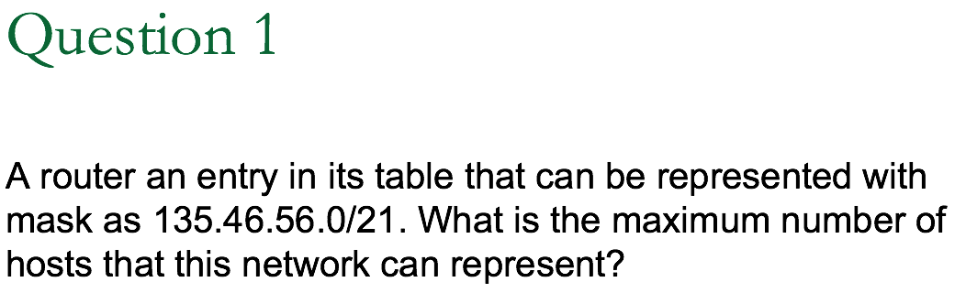
21 bits means network has 21 bits reserved
In total, 32bits for IP address
So, remaining 11 bits are for hosts
2¹¹ hosts

Slide 17
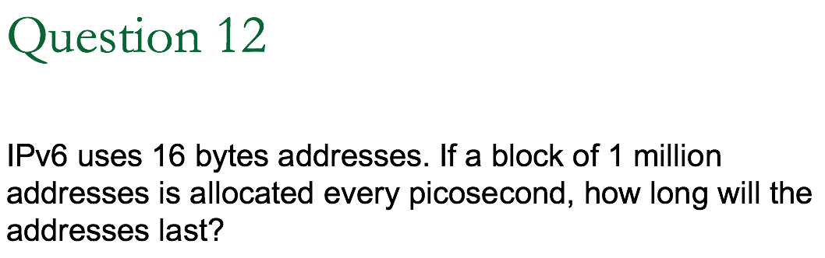
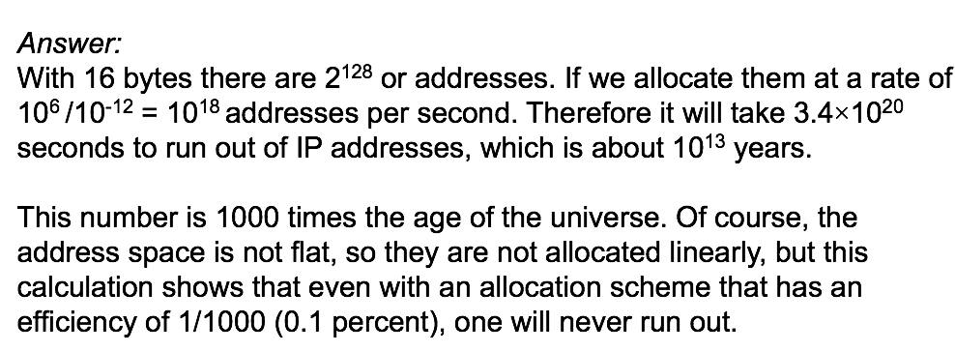
IPv4 uses 4 bytes = 32bits addresses
IPv4 uses 16 bytes = 128 bits address
picosecond = 10⁻¹² second

